Slide 1
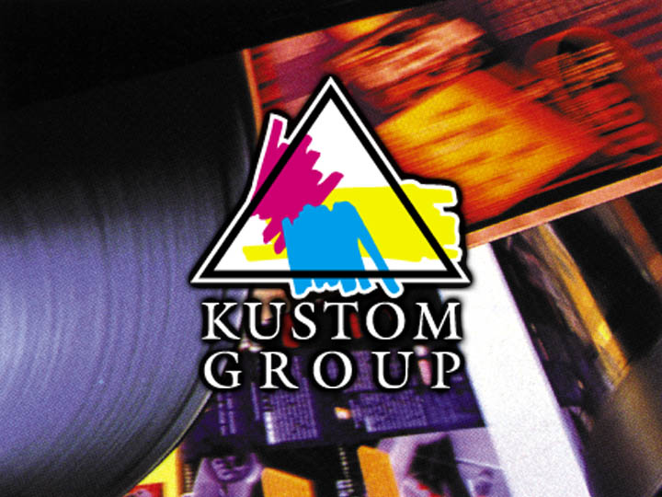
Who is Kustom Group?

Slide 2
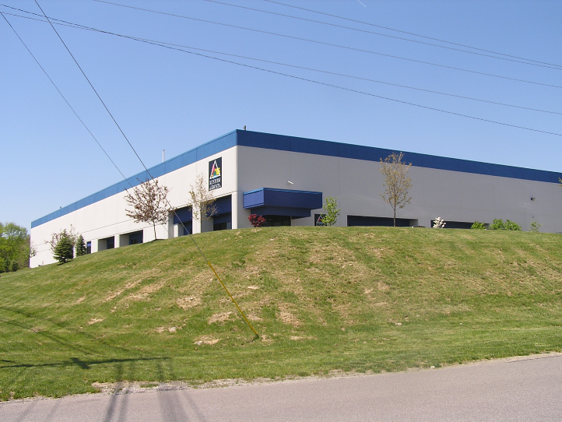
Kustom Group
Corporate Headquarters
Richwood, Kentucky

Slide 3
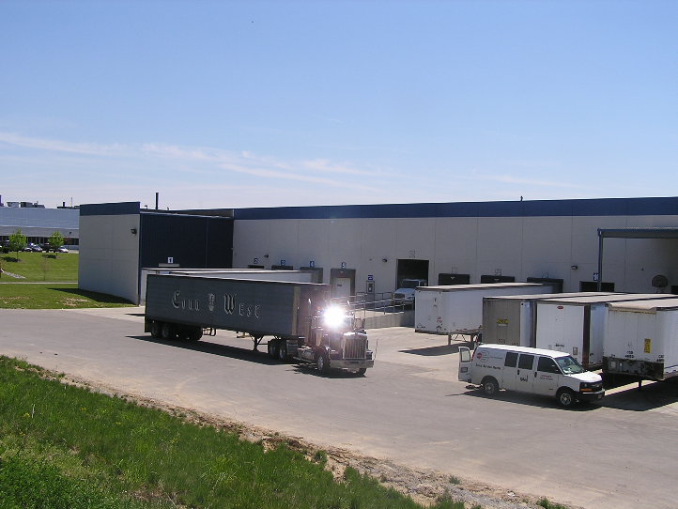
Kustom Group Shipping & Receiving
Richwood, Kentucky

Slide 4
Kustom Group’s Mission
To be the “Value Added Supplier of Choice” for our customers. This includes not only specialty products but specialty packaging such as 1, 3 and 5 gallon buckets, 30 and 55 gallon drums, totes and bulk tankers. Many of these are available in multiple materials like metal, plastic and fiber.
To make as many different products in as many different chemistries as possible so our customers can bundle the majority of their needs on one shipment.
To have the most technical knowledge of any supplier to the Graphic Arts market. Our technical knowledge includes product chemistry, various substrates, ink formulating and manufacturing, printing and coating applications, printing presses and post printing equipment.
Focus on innovative product development providing the profits needed to grow and improve while adding value to customers.
To manufacture products in a safe work environment for our employees and with as little negative impact on our environment as possible.
Be responsible with finances assuring our customers of our long term viability and the long term viability and consistency of our products.
To be the most customer friendly supplier in the market. We make it easy to work with us by giving good complete answers to questions in a timely manner and with the utmost courtesy.

Slide 5
Who is Kustom Group?
Kustom Group is actually made up of two companies; Kustom Blending and Kustom Services.
Kustom Blending manufactures Oilbased ink vehicles, overprints, waxes and additives.
Kustom Services manufactures Waterbased and Energy Curable ink vehicles, overprints and additives.

Slide 6
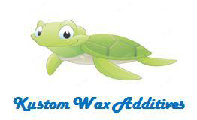
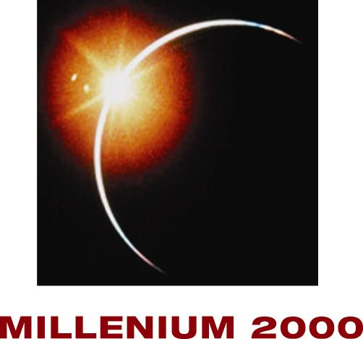
Kustom Blending Products
Kustom Group
GREENMASTER
KUSTOM
KLYDESDALE

Slide 7
Kustom Services Products
Kustom Group
GREENMASTER
SANDY FEEL

Slide 8
Raw Materials for Inks
Conventional Offset
Oilbased sheetfed for paper, board and plastic
Oilbased Heatset for paper
EC Offset
UV sheetfed for paper, board, plastic and metal
H-UV sheetfed for paper and board
LED UV sheetfed for paper and plastic
AQ Flexo
Various formulations for different substrates
EC Flexo
UV flexo for paper, board and plastic
LED flexo for paper and plastic

Slide 9
What’s New with Kustom Group?
LED product line
Coatings
Litho OPV’s
Ink Vehicles
Photoinitiator Blends
Formulated for:
Gap Configuration
LED Array Wattage
Final Properties

Slide 10
Review of LED Product Line
Coatings and OPV’s
for Offset Gap |  |  | for Flexo Gap
Code | Description |  | Code | Description
LED-003 | Gloss LED Coating for Offset Gap |  | LED-012 | Gloss LED Coating for Flexo Gap
LED-008 | Offset Roll Coater Gloss LED Coating |  | LED-010 | Satin LED Coating for Flexo Gap
LED-004 | Satin LED Coating for Offset Gap |  | LED-009 | Matte LED Coating for Flexo Gap
LED-018 | Matte LED Coating for Offset Gap
 |  |  | LED-007 | Imprintable Gloss LED Coating for Flexo Gap
LED-019 | Gluable Gloss LED Coating for Offset Gap
LED-184 | Chemical & Water Resistant Matte LED Coating |  | LED-702 | LED Soft Feel Coating for Flexo Gap
LED-024 | Lower Tack Gloss Litho LED OPV |  | LED-681 | Angle Dependent Sparkling Blue LED Coating for Flexo Gap
LED-026 | Lower Tack Satin Litho LED OPV
LED-027 | Imprintable Matte Litho LED OPV |  | LED-701 | LED Emboss Coating for Flexo Gap
LED-028 | Ultra Reticulation Strike-Thru Litho LED OPV
LED-030 | Fine Reticulation Strike-Thru LED Coating for Offset Gap |  | LED-734 | Coarse Sandy LED Coating for Flexo Gap
 |  |  | LED-725 | Fine Sandy Matte LED Coating for Flexo Gap
LED-686 | Silver Pearl LED Coating for Offset Gap
LED-690 | Sparkling Blue Angle Dependent LED Coating for Offset Gap
LED-703 | Raised LED Coating for Offset Gap
LED-705 | Textured LED Coating for Offset Gap
LED-737 | Coarse Sandy LED Coating for Offset Gap

Slide 11
Review of LED Product Line
Offset Ink Materials
Vehicles and Extenders |  |  | Liquid Photoinitiators
Code | Description |  | Code | Description
LED-258 | Photoinitiated LED Extender for Paper |  | LED-256 | LED Liquid Photoinitiator Blend
LED-259 | LED Extender for Paper |  | LED-257 | LED Gelled Liquid Photoinitiator Blend
KS-386 | UV/LED Fast Cure Litho Gel Vehicle |  | LED-252 | LED Liquid Photoinitiator for White Inks
KS-357 | Highly Functional Urethane Vehicle

Slide 12
Most Popular Heatset Wax Compound Products
Heatset Wax Compounds for optimal slip, gloss-retention, and rub.
Product | Polymer Type | NVM (%) | Description
KBW-TH1 | Microcrystalline Blend | 74-80 | Good gloss retention and rub resistance.
KBW-TH3 | Microcrystalline Blend | 96-100 | Increases viscosity and structure of the ink. Good slip, high solids.
KBW-6819 | Microcrystalline Blend | 68-72 | Good heat and rub resistance with high gloss retention.
KBW-6603 | PTFE | 85-89 | Easy to use PTFE compound. Contains ~50% PTFE.

Slide 13
Most Popular Sheetfed Wax Compound Products
Sheetfed Wax Compounds for optimal rub-resistance, slip and gloss-retention
Product | Polymer Type | NVM (%) | Description
KBW-TF100 | Polyethylene | 96-100 | Workhorse poly compound with excellent rub resistance & good gloss retention.
KBW-TF100S | Polyethylene | 96-100 | Economical, high soya content poly compound. Outstanding gloss retention and rub.
KBW-PY1 (Polytech) | Polyethylene | 96-100 | Unique blend of various density poly waxes for excellent rub and scuff resistance.
KBW-5568D | PTFE/Poly Wax Blend | 96-100 | Easy to use PTFE compound. Contains ~50% PTFE. Best for surface slip.
KBW-PY500 (Polytech 500) | Polyethylene/PTFE | 96-100 | Ideal ratio of poly wax & PTFE in compound form. Excellent rub, surface slip & gloss retention.

Slide 14
Most Popular Specialty Additives
Sheetfed Tack Reducers
KBW-7015D - Pomade Tack Reducer (lowers tack without adverse effect on viscosity)
KBW-7026 - Lubricant Compound for Idle Rollers (dead unit compound)
KB-746 - Gelled Linseed Oil Tack Reducer
KB-783 - Gelled 52 Oil
KBW-6490D - Petrolatum Tack Reducer and Blanket Release Additive
Anti-Misting Bodying Compound
KB-784 - Anti-Misting Compound for Oil Base and Hybrid
KB-767 - Liquid “Body Builder” (Use in place of dry additives)
Anti-Skinning
KB-724 - 25% BHT in Soya Oil
KB-780 - HQMME compound
KBW-5124 – Hydroquinone solution
Anti-Offset Additive
KBW-7045D - Anti-Offset Compound
Non-Piling
KB-750 - Kentucky Lube (activated by fountain solution for non-piling)
KBW-7051D - Wax Paste Tack Reducer (adds lubricity, reduces picking)
Water Pick-Up Control
KBW-8280 - Water Block – Water Pickup Reducer
KB-791 - Water Block – Water Pickup Reducer

Slide 15
Energy Cure Wax Compounds
UV Wax Compounds for optimal slip, gloss-retention, and rub
Product | Description | Ave particle size (μm) | Description
KSW-UV100 | UV High Rub Wax Blend Compound | 5 | Maximizes rub and abrasion. Improves nickel/fingernail scratch on non-porous substrates.
KSW-UV200 | UV Nestle Compliant Carnauba Wax Compound | 6 | Reduces COF, good scratch, water resistance and anti-blocking with high gloss retention.
KSW-UV300 | UV Nestle Compliant PTFE Compound | 5 | Easy to use ~50% PTFE dispersion for Nestle-compliant applications.
KSW-UV400 | UV Nestle Compliant Polyethylene Wax Compound | 5 | Excellent rub resistance. Considered coatable or imprintable.

Slide 16
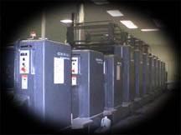
Pressroom Experience
We formulate for the pressroom
We test on press
We think printing

Slide 17
Coating Process
Pumping the coating
Types of coaters
Applying the coating
Drying the coating

Slide 18
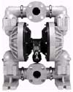
Coating Pump Manufacturers
Harris & Bruno
Technotrans
Tresu Royse
Warren Rupp
Aero

Slide 19
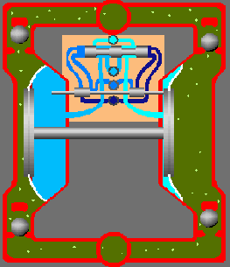
Coating Pump Types
Double Diaphragm Pump
Most popular and very reliable
Excellent suction/pressure ratio
2~5 year life
Relatively inexpensive
UV applications requires special wetted end parts

Slide 20
Coating Pump Types
Watson-Marlow Bredel’s
Peristaltic Pump
“Heart Lung” pump
Quick AQ/UV changeover
Few parts to wear
Good UV pump non anilox
AQ can develop flow issues because of slower flow rates
Two pumps may be needed for feed/return setup

Slide 21
Types of Coaters
Blanket coater
Anilox coater
2 & 3 roll tower coaters
Enclosed doctor chamber

Slide 22
Types of coaters
Blanket Coaters
Two or three roll system
Old technology
Settings difficult
Rubber roller compatibility with coating material
Anilox
Better than roll systems
Blanket cleaning tough
Settings difficult
Low BCM anilox needed for mid-press application- 6.5 BCM
Dahlgren Anilox Blanket Coater
Heidelberg Modular Coating System

Slide 23
Types of Coaters
2 or 3 Roll Tower Coaters
Very common
Excellent gloss coating application
Matte coating can be troublesome
Coating weight varies with roller speeds
.3~.45 pounds /1,000 sq feet average
Require periodic roller adjustments
Two roll coater prone to leaking
Rubber roller compound may limit use to UV or AQ
KOMORI 3-roll coater

Slide 24
Enclosed Doctor Chamber
Harris & Bruno
North American leader
Chamber loading is hydraulic
Seals are inexpensive
PLC driven coating pump

Slide 25
Aqueous Ink Unit Applied OPV
Heatset, Sheetfed and Digital
Gloss
Satin
Matte
Primer

Slide 26
All Kustom's coatings are Zinc Oxide free
All Kustom’s coatings are Alcohol free
All Kustom’s coatings have minimal VOC’s
The above results in very low odor in all coatings
Standard packaging is fiber drum @ 480 lbs. net
Kustom offers a wide variety of coatings

Slide 27
Unique Door Openers
Soft Touch Coating
Sandy Feel Coating
Non-Skid Coating
Pencil Receptive Coating
Low Burn Coating

Slide 28
Kustom Kure
Energy Cure Coatings
Coatings available for UV, EB, H-UV and LED
Coatings for all application methods
Blanket
Roller
Anilox
Gloss, Matte and Satin
Coatings for most substrates
Paper
Plastic
Foil & Metal
Unique Characteristics
Reduced and BZP Free
Low Yellowing
CA Prop 65-Compliant

Slide 29
Kustom Kure
Energy Cure Coatings
Unique Door Openers
KS-686 UV Pearlescent Coating
KS-575 UV Low Finger Print Coating
KS-492 UV Release Coating
KS-696 UV BZP Free, Low Odor Coating
KS-460 UV Gloss Foil Stampable Coating
KS-552 UV Gloss Non-Skid Coating
KS-584 UV Gloss Dry Erase Coating
KS-661 UV Gloss Coating for Plastic Stock
KS-668 UV Satin Coating
KS-451 UV Matte Coating
KS-21001 UV Gloss Screen Coating

Slide 30
Kustom Kure
Energy Cure OPV’s
Dry offset ink unit applied OPV’s
Lithographic ink unit applied OPV’s
Available in UV, H-UV and LED
Gloss, Matte and Satin
OPV’s for most substrates
Paper
Plastic
Foil & Metal
Unique Characteristics
Imprintable, stampable and gluable
Primers for under ink (sizings)
Cast and Cure

Slide 31
Unique Universal Perspective
Kustom Group has combined our knowledge of coating methods with our knowledge of materials to make oil-based, water-based, energy curable and digital inks to offer our customers a more in-depth knowledge of various applications and what is required of coatings and overprints of all chemistries. Coatings and overprints are not just printed on substrates but over ink too. This expanded knowledge allows Kustom to offer specialty products unique in the industry.

Slide 32
Specialty Products
Pearl
KS-416 | Glistening Gold UV Coating |  | KS-818 | Ultra Blue UV Coating
KS-816 | Platinum Gold UV Coating |  | KS-819 | Ultra Blue UV Coating w/o OB
KS-817 | Platinum Gold UV Coating w/o OB |  | KS-413 | Radiant Red UV Coating
KS-839 | Gold Pearl Satin UV Coating |  | KS-814 | Ultra Red Pearl UV Coating
KS-848 | BZP Free Glistening Gold UV Coating |  | KS-815 | Ultra Green Pearl UV Coating
KF-8076 | Aqueous Flexo Gold Pearl Coating |  | KS-844 | Rutile Green Security BZP Free UV Coating
KS-9821 | Gold Pearl AQ Coating |  | KS-852 | Green Pearl UV Coating
KS-9825 | Iridescent Platinum Gold AQ Coating |  | KS-414 | Vivid Orange UV Coating
KS-405 | Pearlescent Litho UV OPV |  | KS-542 | Blue Cast OB Imprintable Gloss UV Coating
KS-449 | Pearl UV Coating |  | KS-843 | Rutile Blue Security UV Coating
KS-490 | Imprintable UV Silver Pearl Gloss Coating |  | KS-840 | Rutile Gold Security UV Coating w/UV-A Indicator
KS-572 | Silver Pearl Gloss UV Coating |  | KS-841 | Rutile Gold Security UV Coating
KS-625 | Imprintable Silver Pearl Satin UV Coating |  | KS-844 | Rutile Green Security BZP Free UV Coating
KS-686 | Silver Pearl Gloss UV Coating |  | KS-842 | Rutile Red Security UV Coating
KS-686LV | Lower Viscosity Silver Pearl UV Coating |  | KS-846 | Rutile Green UV Coating
KS-806 | BZP Free Silver Pearl UV Coating
KS-813 | Sterling Silver UV Coating |  | KS-454 | Angle Dependent Lilac UV Coating
KS-822 | Matte Pearl Litho UV OPV |  | KS-535 | Angle Dependent Metallic Red UV Coating
KS-835 | Silver Pearl H-UV/LE-UV Coating |  | KS-528 | Angle Dependent Blue/Violet Imprintable UV Coating
KS-845 | Silver Security UV Coating |  | KS-675 | Angle Dependent Blue UV Coating
KF-8014 | Flexo Pearl AQ Coating |  | KS-582 | BZP-Free Angle Dependent Blue UV Coating
KF-8070 | Flexo Pearl Coating |  | KS-631 | Angle Dependent Blue UV Coating for In-Line HS Ink
KS-9076 | Kustom Kote Aqueous Pearl Coating |  | KS-9818 | Angle Dependent Blue AQ Coating
KS-9132 | Low Curl Pearl AQ Coating |  | LED-681 | Angle Dependent Sparkling Blue LED Coating for Flexo Gap
KS-9804 | Pearl Satin AQ Coating |  | KS-676 | UV Angle Dependent Red Coating
KS-9814 | Silver Pearl Satin AQ Coating |  | KS-820 | Intense Angle Dependent Red, Gold & Green UV Coating
KS-9823 | Polyboard Big Pearl AQ Coating |  | KS-821 | Intense Angle Dependent Purple, Silver & Blue UV Coating
 |  |  | KS-823 | Intense Angle Dependent Green, Red & Orange UV Coating
KS-408 | White Pearl UV Coating |  | KS-824 | Intense Angle Dependent Gold, Green & Blue UV Coating
KS-9813 | Shimmering White AQ Coating |  | KS-825 | Intense Angle Dependent Lite Blue, Blue & Violet UV Coating
KS-9826 | White Pearl Low Burn AQ Coating |  | KS-826 | Intense Angle Dependent Red, Copper & Gold UV Coating
 | *Typical application with 7-12 BCM anilox roller

Slide 33
Specialty Products
Sandy Feel
KS-148 | KY Shine - Sandy Matte Heatset OPV
KS-9810 | Sandy Gloss Aqueous Coating
KS-9838 | Polyboard Sandy Gloss AQ Coating
KS-9822 | Stable Sandy Satin AQ Coating
KS-9815 | Sandy Matte Aqueous Coating
KS-9820 | Coarse Sandy Feel Semi-Satin AQ Coating
KS-521 | Sandy Gloss UV Coating
KS-600 | Satin Sandy UV Coating
KS-600HV | High Viscosity Satin Sandy UV Coating
KS-411 | Sandy Matte UV Coating
KS-446 | Ultra Matte Sandy UV Coating for Oil Based Ink
KS-469 | Sandy Matte UV Coating for Plastic
KS-433LV | Low Viscosity Coarse Sandy Feel UV Coating
KS-433 | Coarse Sandy Feel UV Coating
KS-558 | BZP Free Coarse Sandy Feel Matte UV Coating
KS-834 | Fine Sandy Satin H-UV/LE-UV Coating
KS-809 | Sandy Matte H-UV Coating
KS-833 | H-UV Sandy Feel Matte UV Coating
KS-805 | BZP Free Coarse Matte Sandy Feel H-UV Coating
LED-725 | Fine Sandy Matte LED Coating for Flexo Gap
LED-734 | Coarse Sandy Feel LED Coating for Flexo Gap
KS-21006 | Sandpaper Screen UV Coating
 | Most run 8-20 BCM from fine feel to more feel
 | KS-433 requires 35 BCM or higher with max grit
 | KS-21006 80-320 mesh to control amount of feel
Textured
KS-605 | Textured UV Gloss Coating
KS-804 | BZP Free Flexible Textured UV Gloss Coating
KS-520 | Textured Matte UV Coating
 | Apply 8-25 BCM and may require special pumping
Glitter
KS-466 | UV Gold Glitter Coating
KS-847 | Light Gold Large Glitter UV Coating
KS-828 | Silver Glitter Array UV Coating
KS-598 | Bright Silver Glitter UV Coating
KS-803 | Bright Silver Glitter BZP Free UV Coating
KS-666 | Combination Glitter Kure UV Coating
KS-563 | BZP Free Silver Glitter UV Coating
KS-9808 | Glitter Kote AQ Coating
KS-9824 | Polyboard Silver Glitter AQ Coating
KS-807 | BZP Free Holographic Splintered Glitter UV Coating
KS-827 | Raised Holographic Splintered Glitter Matte UV Coating
KS-452 | Glittering White Matte UV Coating
 | * Typical application with 40 BCM or higher
Sparkle
KS-418 | UV Sparkling White UV Coating
KS-615 | Sparkle Gloss UV Coating
KS-627 | Crystal Silver UV Coating
KS-664 | Sparkle Kure UV Coating
KS-831 | Sparkle H-UV/LE-UV Coating
KS-9816 | Sparkle Kote AQ Coating
KS-21012 | Sparkle Screen UV Coating
KS-512 | Sparkling Gold UV Coating
KS-9819 | Sparkling Gold AQ Flexo Coating
 | * Typical application with 25 BCM or higher

Slide 34
Specialty Products
Strike-Thru
KS-9000 | Gloss AQ Coating
KB-3074 | Sheetfed Strike-Thru Dull OPV
KS-9020 | High Gloss AQ Coating
KB-3011 | Smooth Strike-Thru SF OPV**
KS-453 | High Gloss UV Coating for Smooth Strike-Thru
KS-618 | BZP-Free Gloss UV Coating for Smooth Strike-Thru
KB-3116 | Sheetfed Smooth Strike-Thru OPV for UV*
KB-3011 | Smooth Strike-Thru SF OPV**
KS-688 | High Gloss UV Coating for Reticulation Strike-Thru
KB-3115 | UV Reticulation Strike-Thru SF OPV
KUL-2300 | Foil Stampable Gloss UV Coating
KB-3199 | Reticulation Matte OPV
KS-494 | Imprintable Gloss UV Coating
KS-568 | Strike-Thru Matte UV OPV***
KS-836 | Ultra Reticulation Strike-Thru Gloss Litho UV OPV
KS-460 | Foil Stampable Gloss UV Coating
KS-599 | Reticulation Strike-Thru Gloss Litho UV OPV
KS-855 | Low Energy Curing Gloss Coating for Smooth Strike-Thru
KS-800 | BZP Free Reticulation Strike-Thru Gloss H-UV Coating
KS-854 | Reticulation Strike-Thru H-UV Coating
KS-899 | Reticulation Strike-Thru Gloss Litho H-UV OPV
KS-494 | Imprintable Gloss UV Coating
KB-3217 | Wet EC Ink Smooth Strike-Thru SF OPV
LED-028 | Ultra Reticulation Strike-Thru Litho LED OPV
LED-019 | Gluable Gloss LED Coating for Offset Gap
*Best contrast, slowest drying
**Good contrast, low yellowing and faster dry
***Least contrast but fastest dry/cure
Soft Feel
KS-143 | Kentucky Shine Matte Web "Soft-Feel" OPV
KS-146 | KY Shine Soft Feel Matte SF OPV
KS-9800 | Soft Feel AQ Coating
KS-9812 | Smoother Lay Soft Feel AQ Coating
KS-9812HV | High Viscosity Smoother Lay Soft Feel AQ Coating
KS-9890 | Smooth AQ Soft Feel Coating
KS-532 | Soft Feel Matte UV Coating
KS-532LV | Soft Feel Lower Viscosity Matte UV Coating
KS-540 | Faster Curing Soft Feel UV Coating
KS-540LV | Faster Curing Soft Feel UV Coating
KS-540HV | Faster Curing High Viscosity Soft Feel UV Coating
KS-555 | UV Soft Feel Pearl Effect Coating
KS-830 | 100% UV Soft Feel Coating
LED-702 | LED Soft Feel Coating for Flexo Gap
 | Typical application 8-14 BCM
Rubber Feel
KS-475 | Rubber Feel UV Coating
KS-551 | BZP Free Rubber Feel Gloss UV Coating
Apply 25 BCM or more and may require special pumping
Raised
KS-495 | Water Droplet Raised UV Coating
KS-508 | Raised High Gloss UV Coating
KS-838 | Raised High Gloss H-UV/LE-UV Coating
KS-21010 | Raised UV Screen Coating
Apply 40 BCM or more and may require special pumping
KS-21010 recommend 180-220 mesh

Slide 35
Digital Options
UV Coatings for over Digital Printing
KS-427 Gloss UV Coating for Toner based inks
KS-439 Gloss UV Coating for over Ink Jet ink on Ink Jet paper.
KS-450HV Gloss UV Coating for over digital (i.e. HP Indigo, iGen)
KS-507 Highest Gloss UV Coating for over various Digital inks. Must have high volume anilox (25+BCM) or a heated reservoir.
KS-451LV Matte UV Coating for over various Digital Ink Jets.
Aqueous Coatings for over Digital Printing
KS-9850 AQ Gloss coating for over HP Indigo and Xerox digital inks
KS-9851 AQ Primer coating for over HP Indigo and Xerox digital inks
KS-9853 AQ Satin coating for over HP Indigo and Xerox digital inks
KS-9855 AQ Matte coating for over Xerox iGen digital inks
KS-9856 AQ Matte coating for over HP Indigo and Ricoh digital inks
Oilbased Litho OPV’s
KB-3164 Gloss Litho Sheetfed OPV for over HP Indigo Ink
KB-3179 Satin Sheetfed OPV for over HP Indigo Ink
KB-3187 Matte Sheetfed OPV for over HP Indigo Ink
HP Indigo Sizing (on paper under ink)
KS-9845 Indigo Sizing/AQ Primer for paper
KS-9849 Indigo Sizing/AQ Primer for plastic and in-line applications
KS-9848 AQ Inkjet Sizing

Slide 37
Strike-Thru Combinations
Smooth AQ – KB-3074 + KS-9000
Smooth UV – KB-3116 + KS-453
Reticulation UV – KB-3115 + KS-688
All UV Smooth – KS-568 + KS-453
All UV Reticulation – KS-836 + KS-494
Best to run as a pair
New opportunities for business

Slide 38
Thank you for your attention!
Are there any questions?

